Slide 1

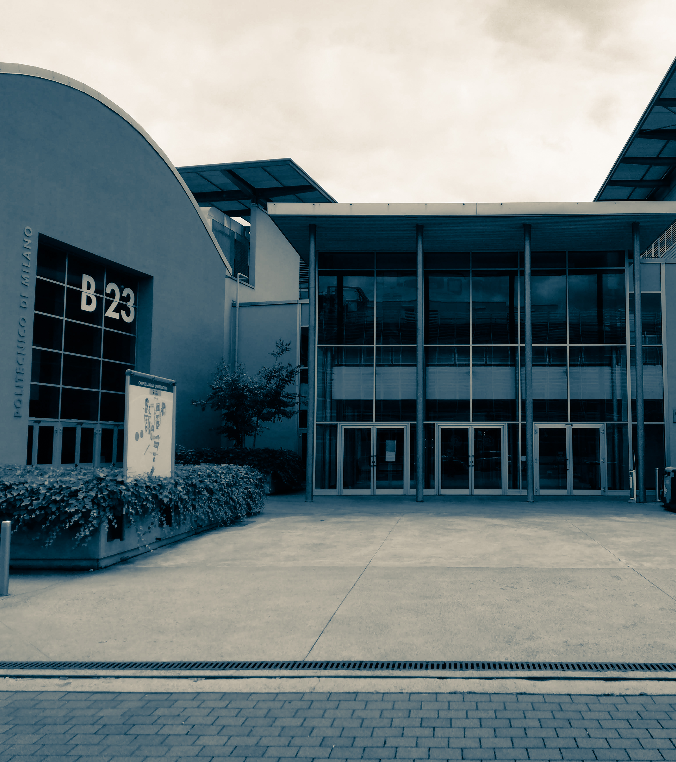
DIPARTIMENTO DI MECCANICA
Department of Mechanical Engineering
Python-aided structural performance-based design optimisation of a secondary mirror for a Concentrated Solar Power (CSP) plant
Lucio Pinello July 10, 2023

Slide 2
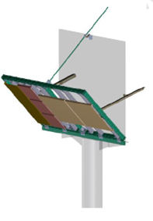
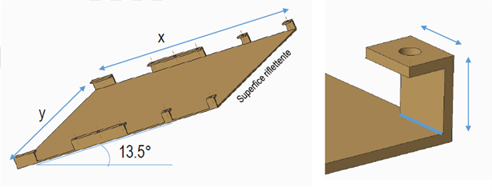
Python-aided structural performance-based design optimisation of a secondary mirror for a Concentrated Solar Power (CSP) plant
Framework:
Concentrating Solar Power (CSP) systems
Solar Power Tower (SPT) plant
Beam-down technology
Secondary mirror optimisation

Slide 3
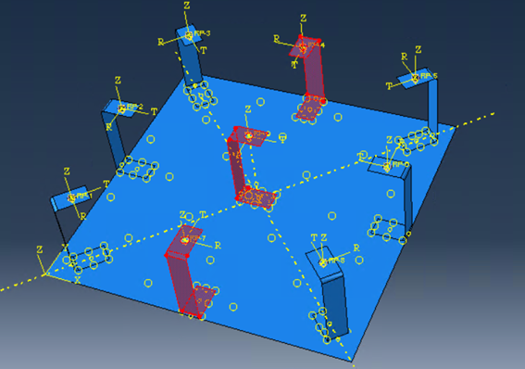
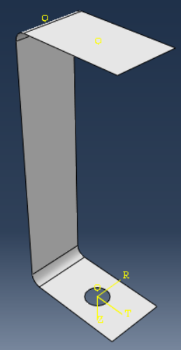
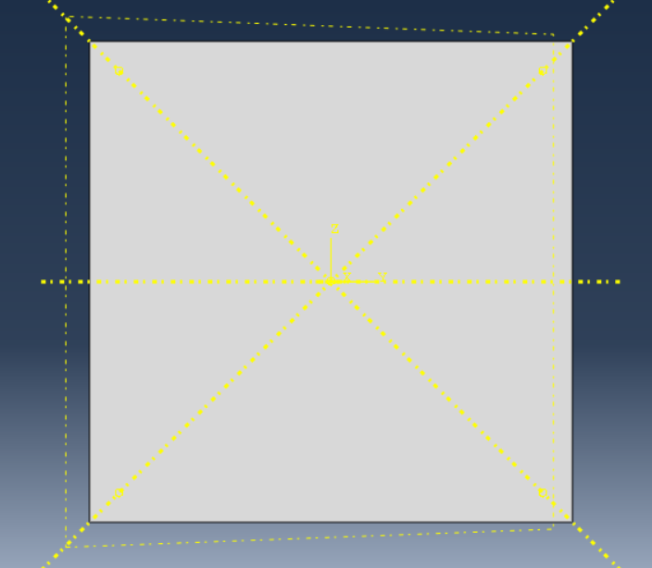
Python-aided structural performance-based design optimisation of a secondary mirror for a Concentrated Solar Power (CSP) plant
Abaqus model:
 | #C | C thickness [mm] | C semi-height [mm] | Plate thickness [mm]
min | 6 | 1 | 40 | 1
max | 9 | 5 | 100 | 5
step | 1 | 1 | 10 | 1
Plate dimensions: 800x800 mm
Bracket width: 50 mm
700 combinations
Load cases
Temperature: 200°C
Weight
Wind: 13 km/h

Slide 4
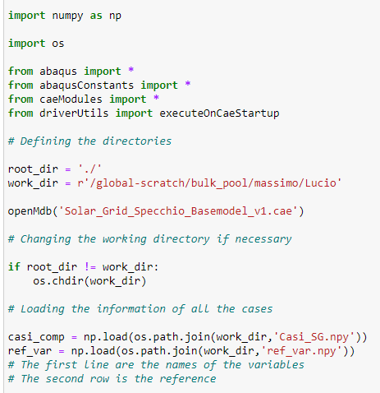
Python-aided structural performance-based design optimisation of a secondary mirror for a Concentrated Solar Power (CSP) plant
Python-Abaqus code:
 | #C | C thickness [mm] | C semi-height [mm] | Plate thickness [mm]
min | 6 | 1 | 40 | 1
max | 9 | 5 | 100 | 5
step | 1 | 1 | 10 | 1

Slide 5
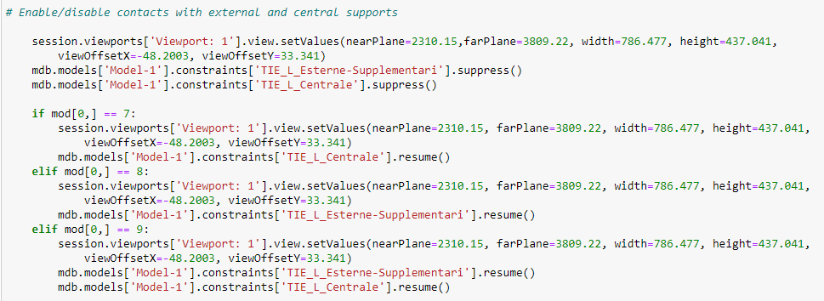
Python-aided structural performance-based design optimisation of a secondary mirror for a Concentrated Solar Power (CSP) plant
Python-Abaqus code:
 | #C | C thickness [mm] | C semi-height [mm] | Plate thickness [mm]
min | 6 | 1 | 40 | 1
max | 9 | 5 | 100 | 5
step | 1 | 1 | 10 | 1

Slide 6
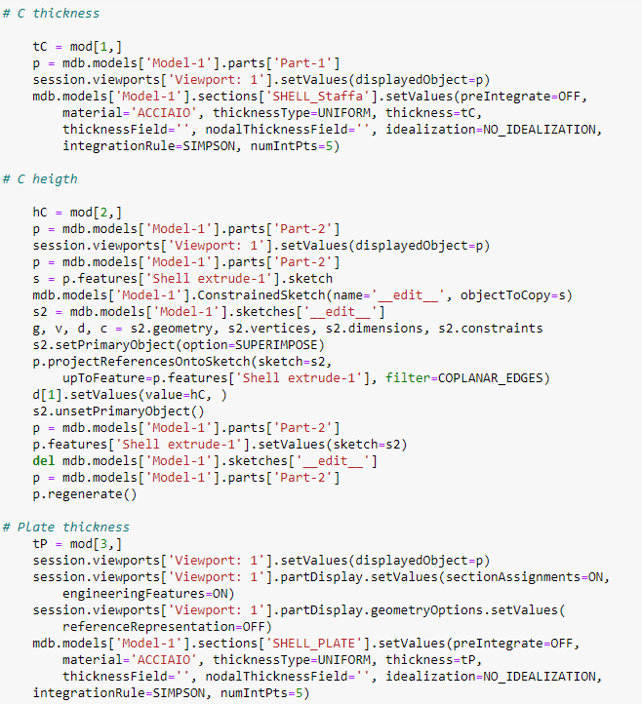
Python-aided structural performance-based design optimisation of a secondary mirror for a Concentrated Solar Power (CSP) plant
Python-Abaqus code:
 | #C | C thickness [mm] | C semi-height [mm] | Plate thickness [mm]
min | 6 | 1 | 40 | 1
max | 9 | 5 | 100 | 5
step | 1 | 1 | 10 | 1

Slide 7
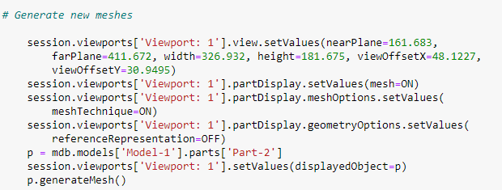
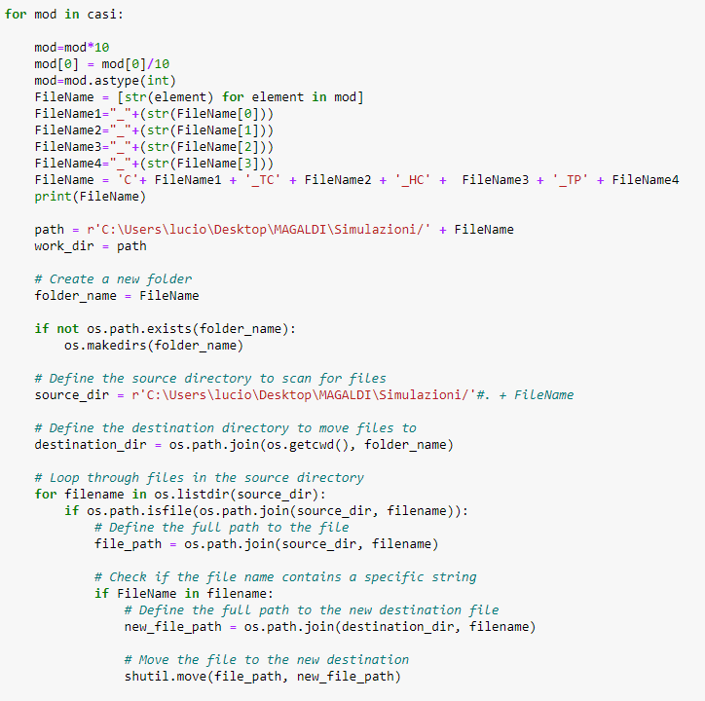
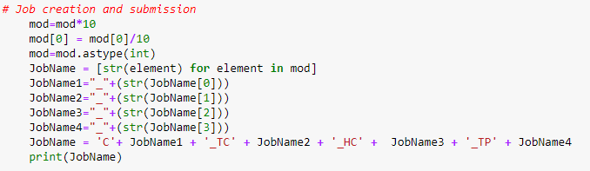
Python-aided structural performance-based design optimisation of a secondary mirror for a Concentrated Solar Power (CSP) plant
Python-Abaqus code:

Slide 8
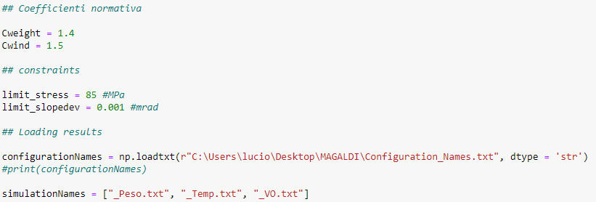
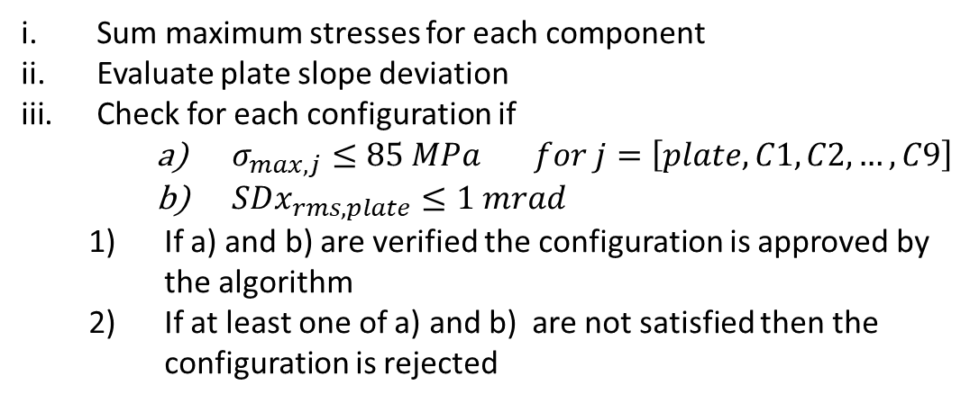
Python-aided structural performance-based design optimisation of a secondary mirror for a Concentrated Solar Power (CSP) plant
Python post-processing code:
Design constraints
Selection algorithm
Plate slope deviation < 1 mrad
Sum maximum stresses for each component
Evaluate plate slope deviation
Check for each configuration if
$σ_{max, j}≤85 MPa for j=\left[plate, C1, C2, …, C9\right]$
$SDx_{rms, plate}≤1 mrad$
If a) and b) are verified the configuration is approved by the algorithm
If at least one of a) and b) are not satisfied then the configuration is rejected
Additional constraint
Maximum stress: 85 MPa
Safety coefficients from Eurocode 3
Weight: 1.4
Wind: 1.5

Slide 9
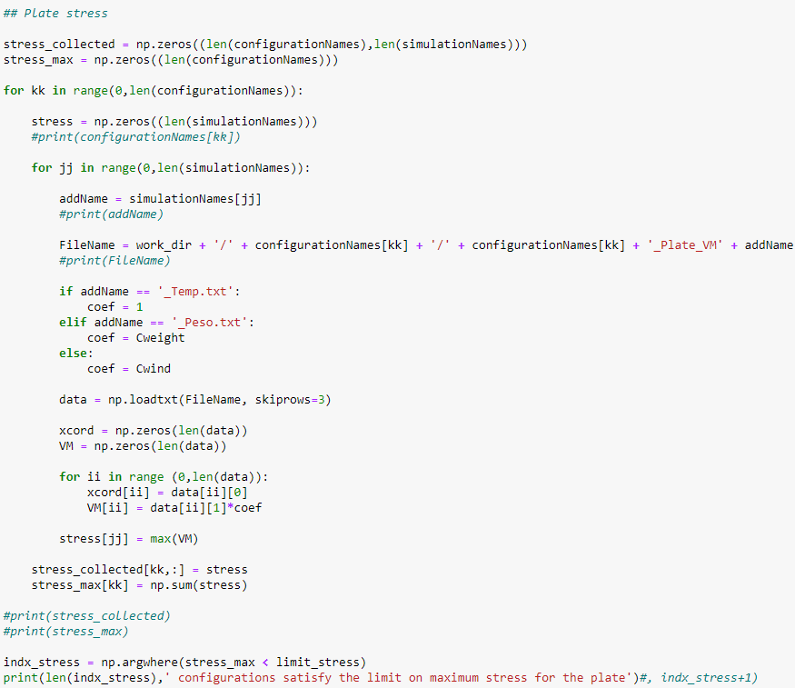
Python-aided structural performance-based design optimisation of a secondary mirror for a Concentrated Solar Power (CSP) plant
Python post-processing code:
Loading configuration load case results
Stress intensification with safety coefficients
Sum stress state from the load cases
Check constraint
VM is the intensified stress state array
stress collects the maxim stress for the kk-th configuration for all the jj-th load cases
stress-collected collects the stress vector, storing the maximum stress for all the configurations and for all the load cases
stress-max collects the sum of the maximum stress of the load cases for the kk-th configuration

Slide 10
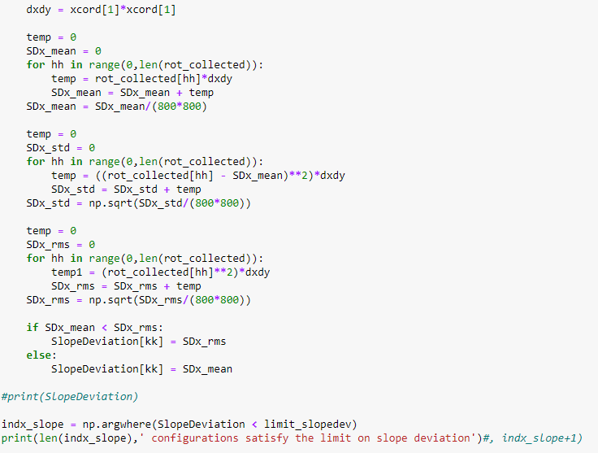
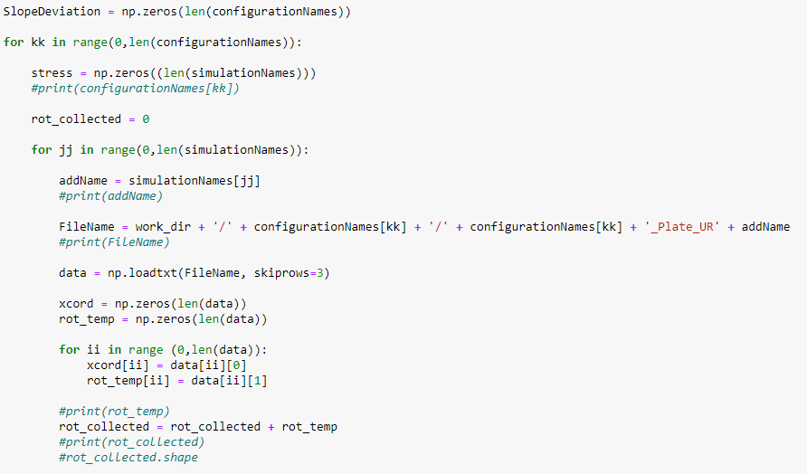
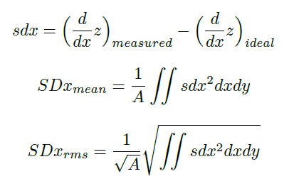
Python-aided structural performance-based design optimisation of a secondary mirror for a Concentrated Solar Power (CSP) plant
Python post-processing code:

Slide 11
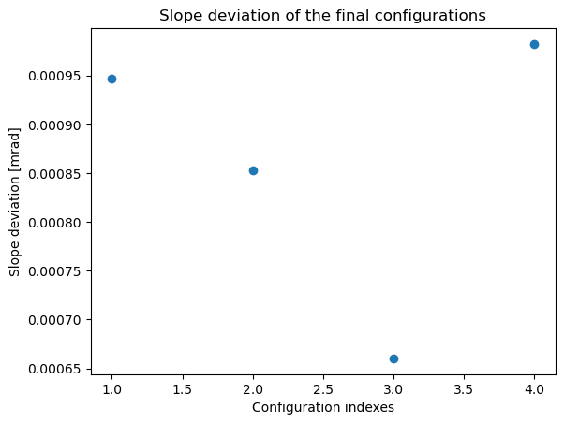
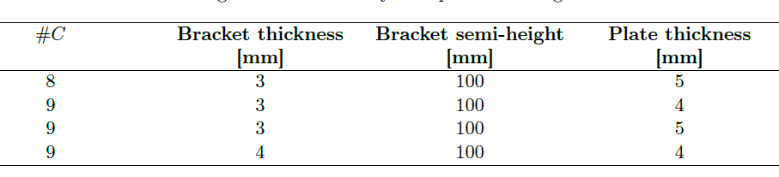
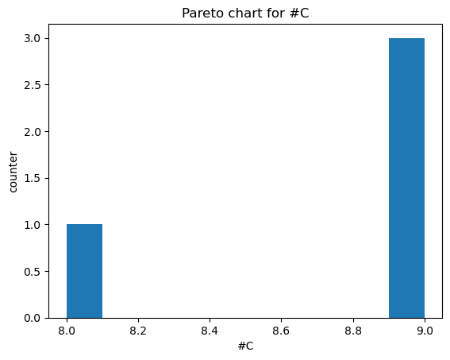
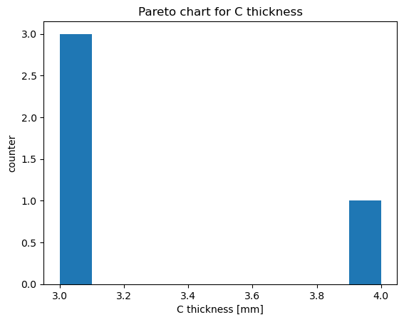
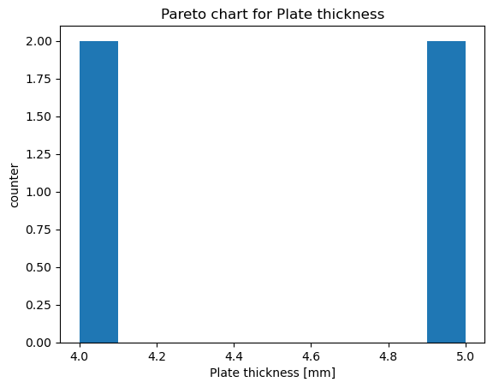
Python-aided structural performance-based design optimisation of a secondary mirror for a Concentrated Solar Power (CSP) plant
Python post-processing code:

Slide 12


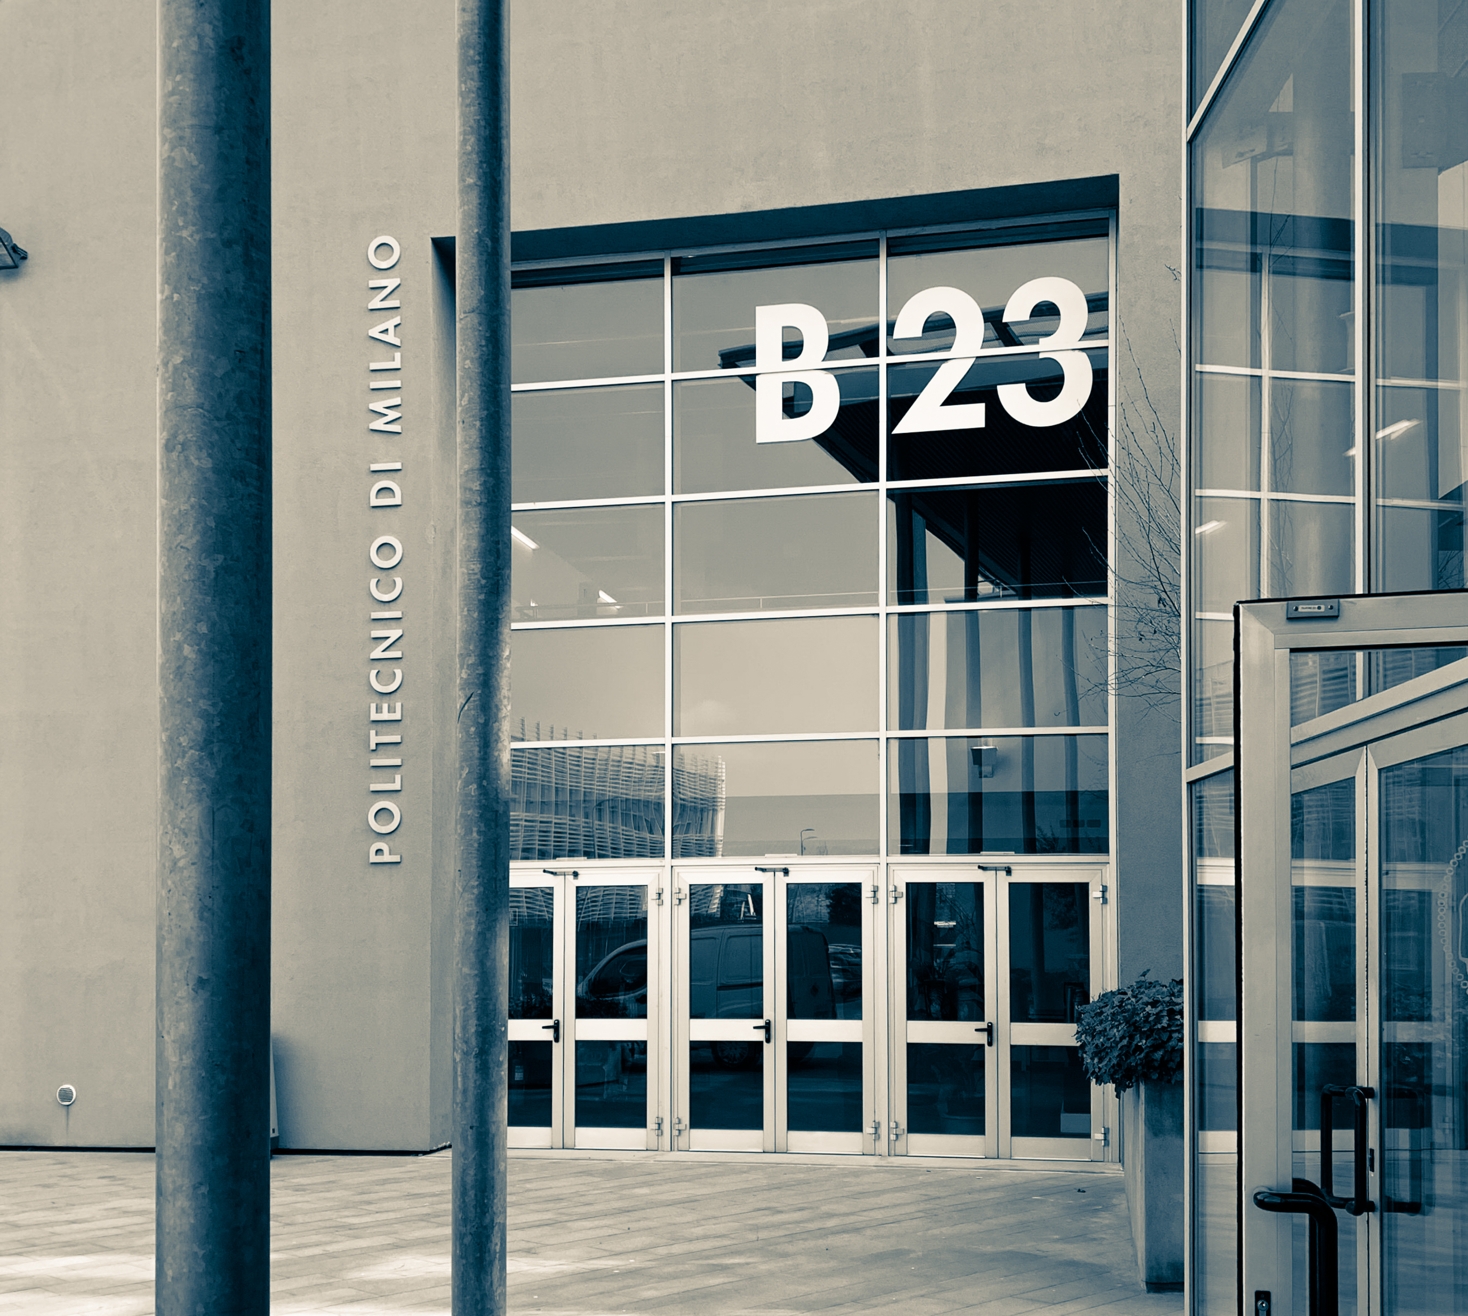
Lucio Pinello
lucio.pinello@polimi.it

